Slide 1
Treaty Gathering
OCETI SAKOWIN OYATE
OCETI SAKOWIN TERRITORY
December 14-16, 2021
Steven Newcomb (Shawnee/Lenape)

Slide 2
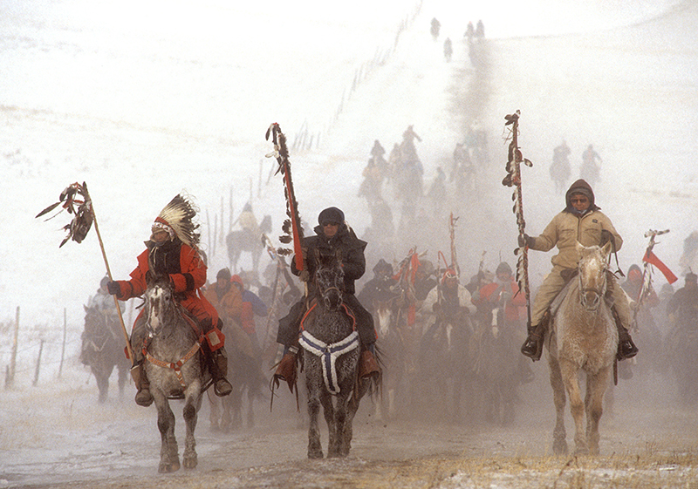
BIRGIL KILLS STRAIGHT (middle)
WOUNDED KNEE MEMORIAL RIDE

Slide 3
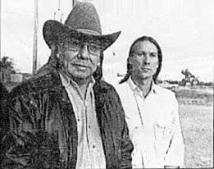
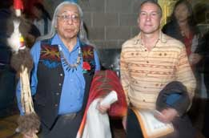
In 1992 The Indigenous Law Institute
Began a Global Campaign
Calling on Pope John Paul II to Revoke the Papal Bull of May 4, 1493

Slide 4
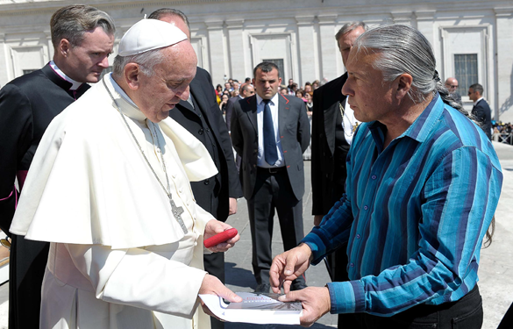
May 4, 2016
523 Years to the Day from the Issuance of one of the Papal Bull Documents

Slide 5
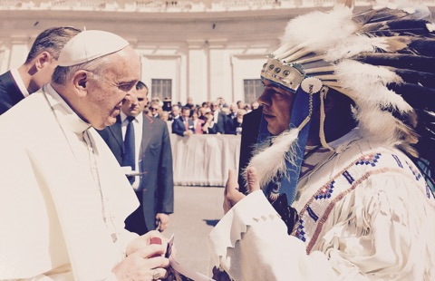
Yakama Nation Chairman JoDe Goudy and Pope Francis, May 4, 2016

Slide 6
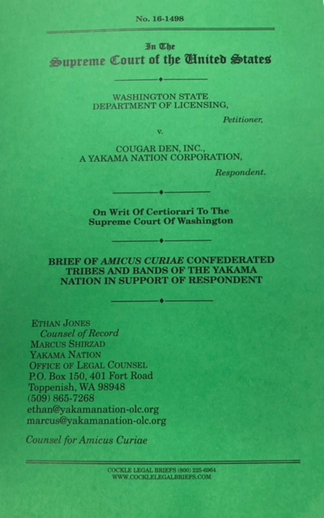
Historic Yakama Nation Amicus Brief Challenging the US Claim of a Right of Domination (2018)

Slide 7
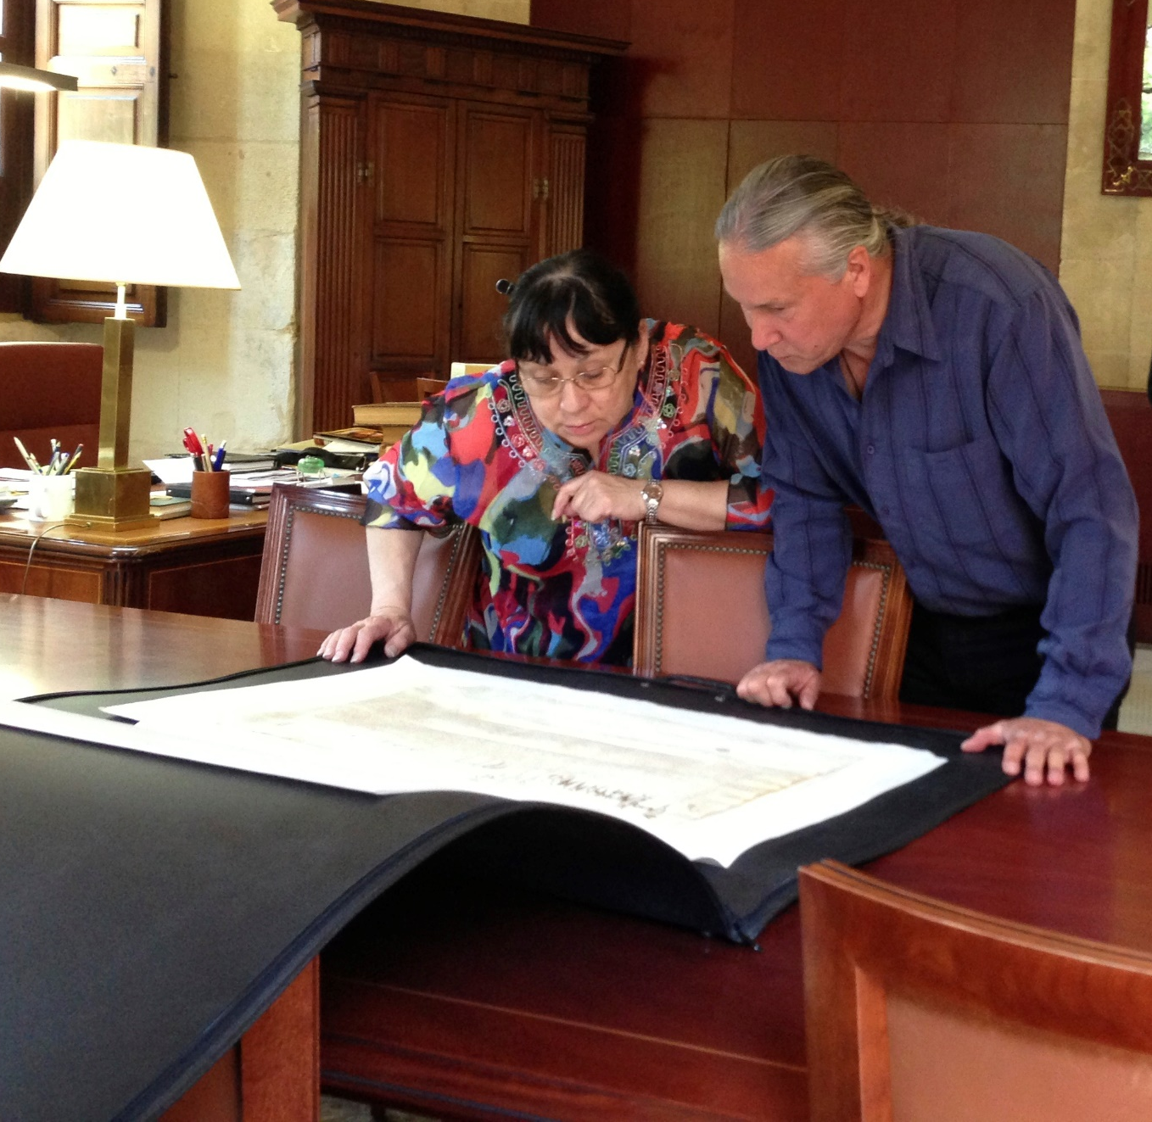
The Archives of the Indies:
The Royal Secretary:
“Ganaran y Conquistaron
Las Indias” (1493)
“To Win and To Conquer [DOMINATE] the Indies”
Original Papal Bull Written in Octupus Ink

Slide 8
“To Win and to Conquer the Indies” = “To Win and to Establish DOMINATION Over the Indies.”

Slide 9
Civilization: “The forcing of a cultural pattern [of Domination] on a population to which that pattern is foreign.” The fact that one people or population is forcing a cultural pattern on another people or population lets us know it’s a process of DOMINATION.

Slide 10
The State: “A relation of men dominating men.” Max Weber
“In order for the State to exist the dominated must submit themselves to, and live in obedience to, the powers of DOMINATION that be.”

Slide 11
Sovereignty: “An unjust form of political domination that limits human freedom.” - Havercroft
Also: “Supremacy [domination] over citizens or subjects unrestrained by the laws.” - Jean Bodin.

Slide 12
Ascendancy: “Controlling influence, governing power, DOMINATION.” – Webster’s Third New International Dictionary
Metaphorical structure: Viewed as existing on a Higher Level than anyone else.

Slide 13
DOMINION: (From “Dominio” meaning “to Dominate”
DOME, as in a Capital Dome
DOMO: To Subjugate (to Yoke)
To Subdue
To Force Into Subservience
To Tame and Domesticate
To Cultivate and to Till

Slide 14
Property: William Blackstone – “Despotic Dominion.”
“The first establishment of socially approved physical domination over some part of the natural world.”

Slide 15
Empire: A political body that has extended its control over a vast geographical area and aspires to continue the maintenance and expansion of its domination.

Slide 16
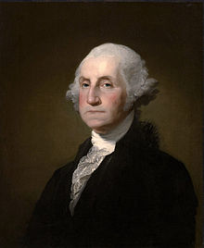
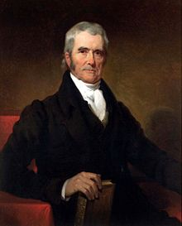
The Rise of the AMERICAN EMPIRE
“OUR NASCENT EMPIRE”
George Washington
“This Our Wide Spreading Empire”
Chief Justice John Marshall

Slide 17
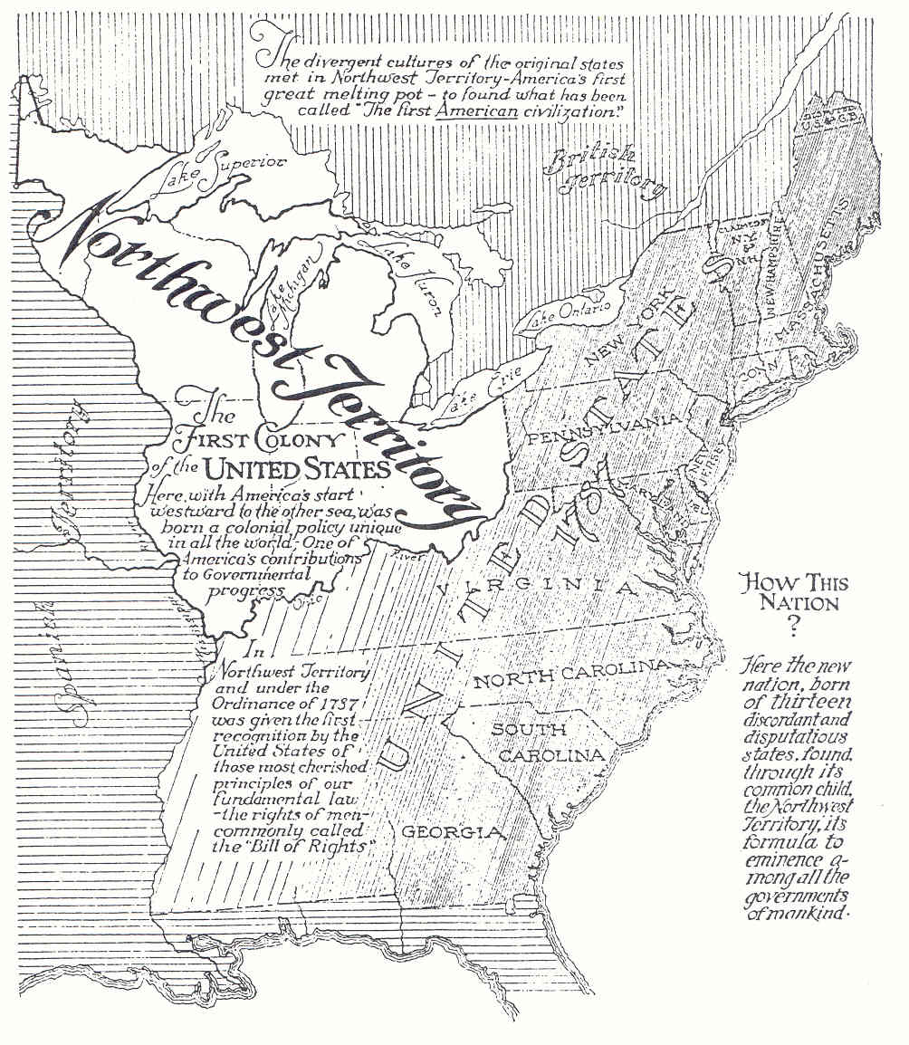

Slide 18
The Northwest Ordinance (1787)
“The utmost good faith shall always be observed toward the Indian, and in his property, rights, and liberty” had never been invaded, or disturbed

Slide 19
Dakota Territorial Act
Chapter LXXXVI.—An Act to provide a temporary Government for the Territory of Dakota, and to create the Office of Surveyor General therein.
“Provided, That nothing in this act contained shall be construed to impair the rights of person or property now pertaining to the Indians in said Territory, so long as such rights shall remain unextinguished by treaty between the United States and such Indians, or to include any territory which, by treaty with any Indian tribe, is not, without the consent of said tribe, to be included within the territorial limits or jurisdiction of any State or Territory; but all such territory shall be excepted out of the boundaries and constitute no part of the Territory of Dakota, until said tribe shall signify their assent to the President of the United States to be included in said Territory . . .”

Slide 20
or to affect the authority of the government of the United States to make any regulations respecting such Indians, their lands, property, or other rights, by treaty, law, or otherwise, which it would have been competent for the government to make if this act had never passed: Provided further, That nothing in this act contained shall be construed to inhibit the government of the United States from dividing said Territory into two or more Territories, in such manner and at such times as Congress shall deem convenient and proper, or from attaching any portion thereof to any other Territory or State.
Source: THIRTY-SIXTH CONGRESS. Sess.II. CH. 85. 1861. Chapter LXXXVI. (The Statutes at Large, Treaties, and Proclamations of the United States of America, from December 5, 1859, to March 3, 1863., Ed. George P. Sanger, Boston: Little, Brown and Company, 1863)

Slide 21
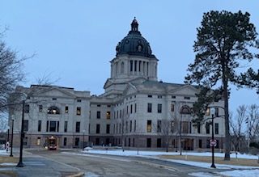

“GOVERNMENT” = “DOMINATION”
In the Latin language, the English word “government” is written as “domination.” Capitol Dome
The System of Domination Called “South Dakota”

Slide 22
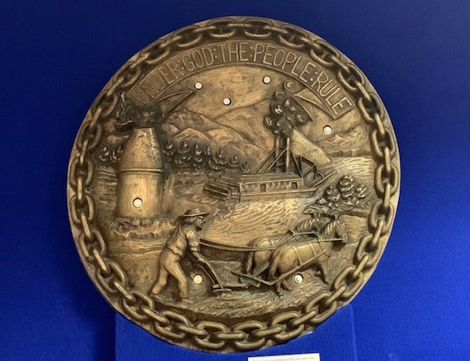

Rule = Dicio
Domination under Regulation
Claiming and Chaining the Lands of Original Nations

Slide 23
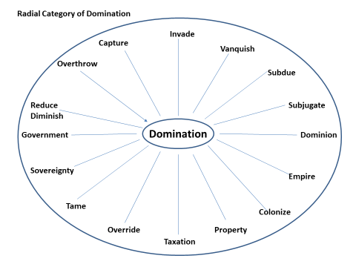

Slide 24
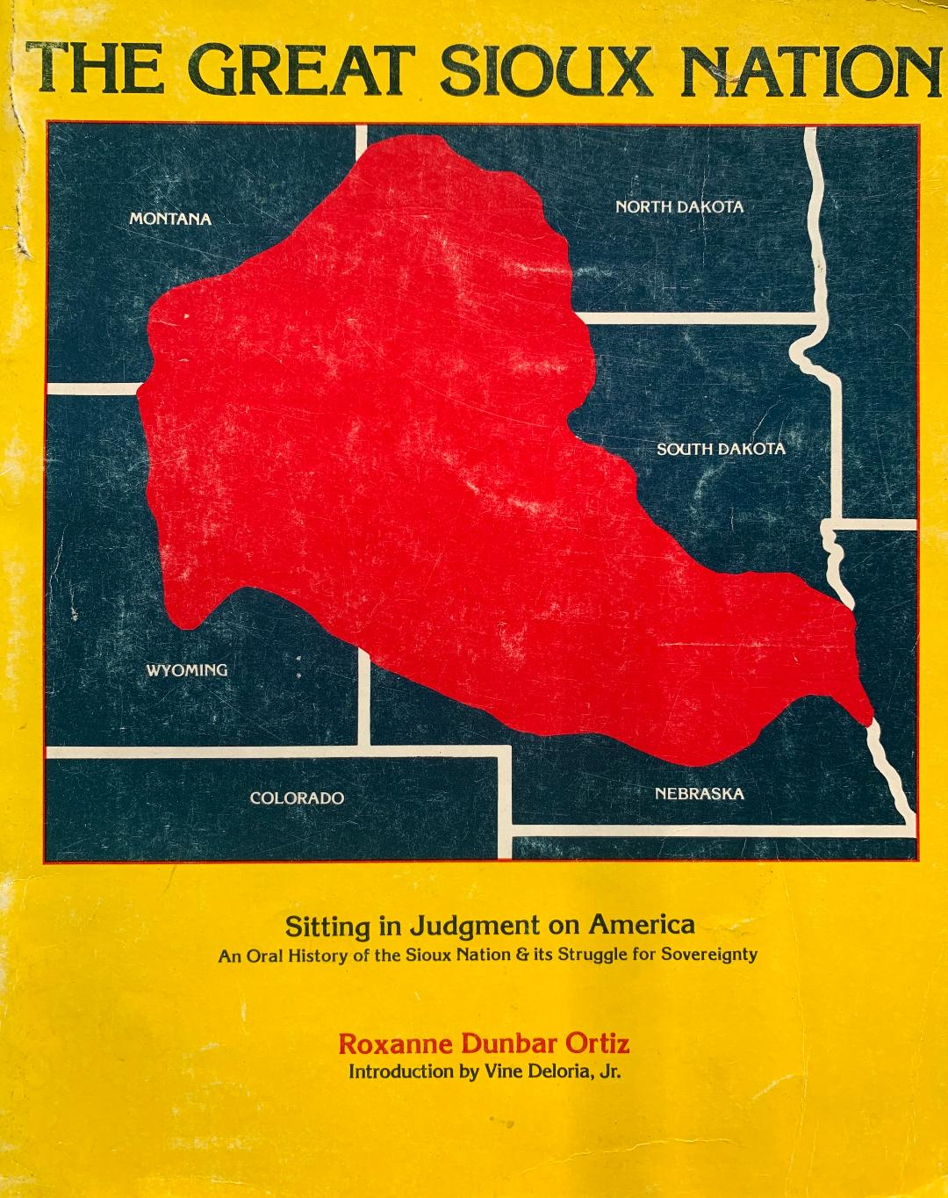

Slide 25
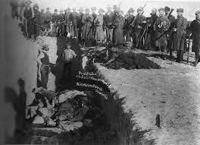
THE WOUNDED KNEE MASSACRE -GENOCIDE
DOMINATION AND DEHUMANIZATION

Slide 26
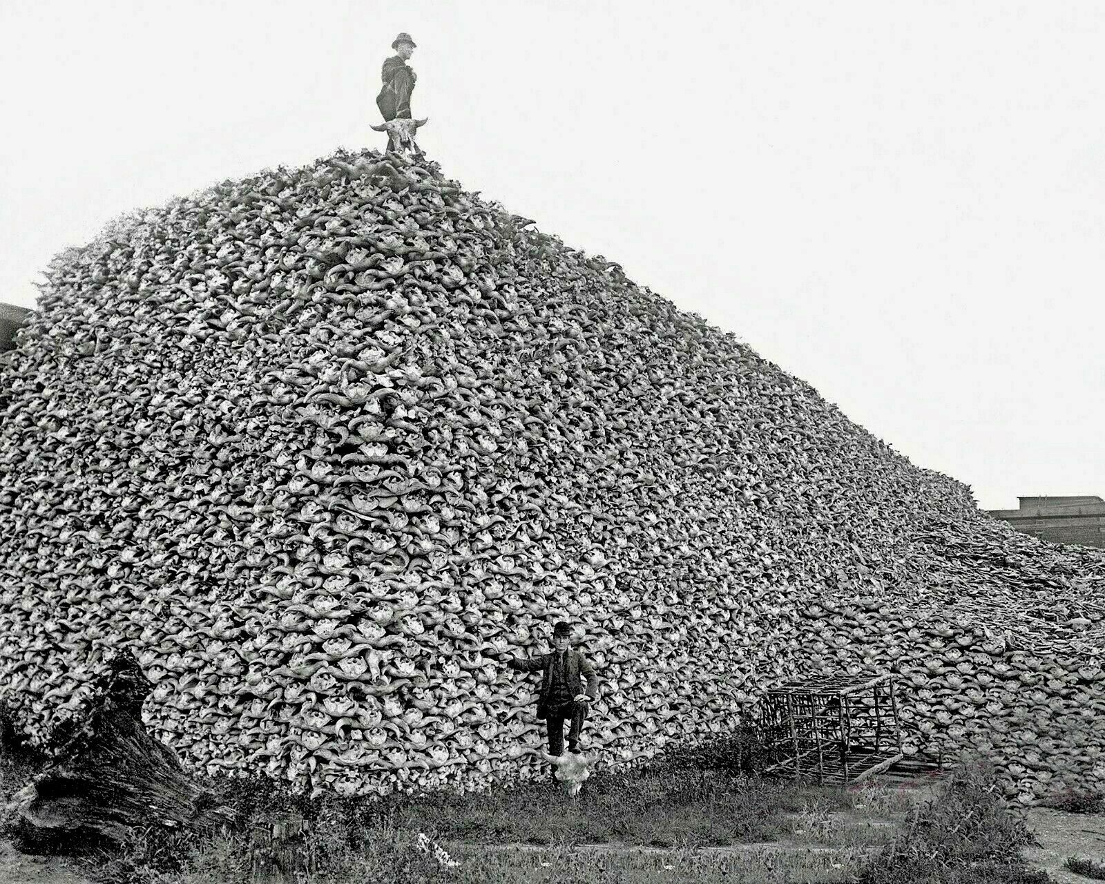

Slide 27
From Judge Warren Urbom’s Memorandum in U.S. v. Consolidated Wounded Knee Cases (1975)
“…official policy of the United States until at least the late 19th century was impelled by a resolute will to control [Dominate] substantial territory for its westward moving people. Whatever obstructed the movement [of US Domination], including the Indians, was to be and was shoved aside, dominated or destroyed.”

Slide 28
Judge Urbom (cont.): “Wars, disease, treaties pocked with duplicity, and decimation of the buffalo by whites drove the Sioux to reservations, shriveled their population and disemboweled their corporate body. They were left a people unwillingly dependent in fact upon the United States.” (Forced to live subject to the idea-system of US Domination)

Slide 29
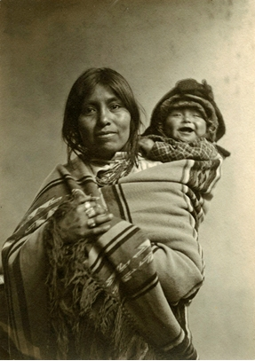
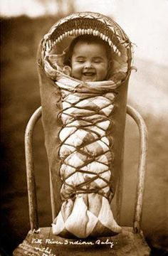
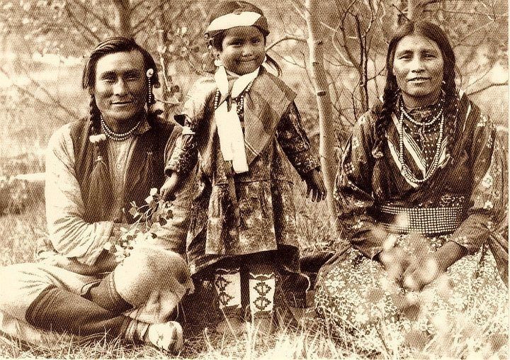
Free and Independent of
Domination

Slide 30
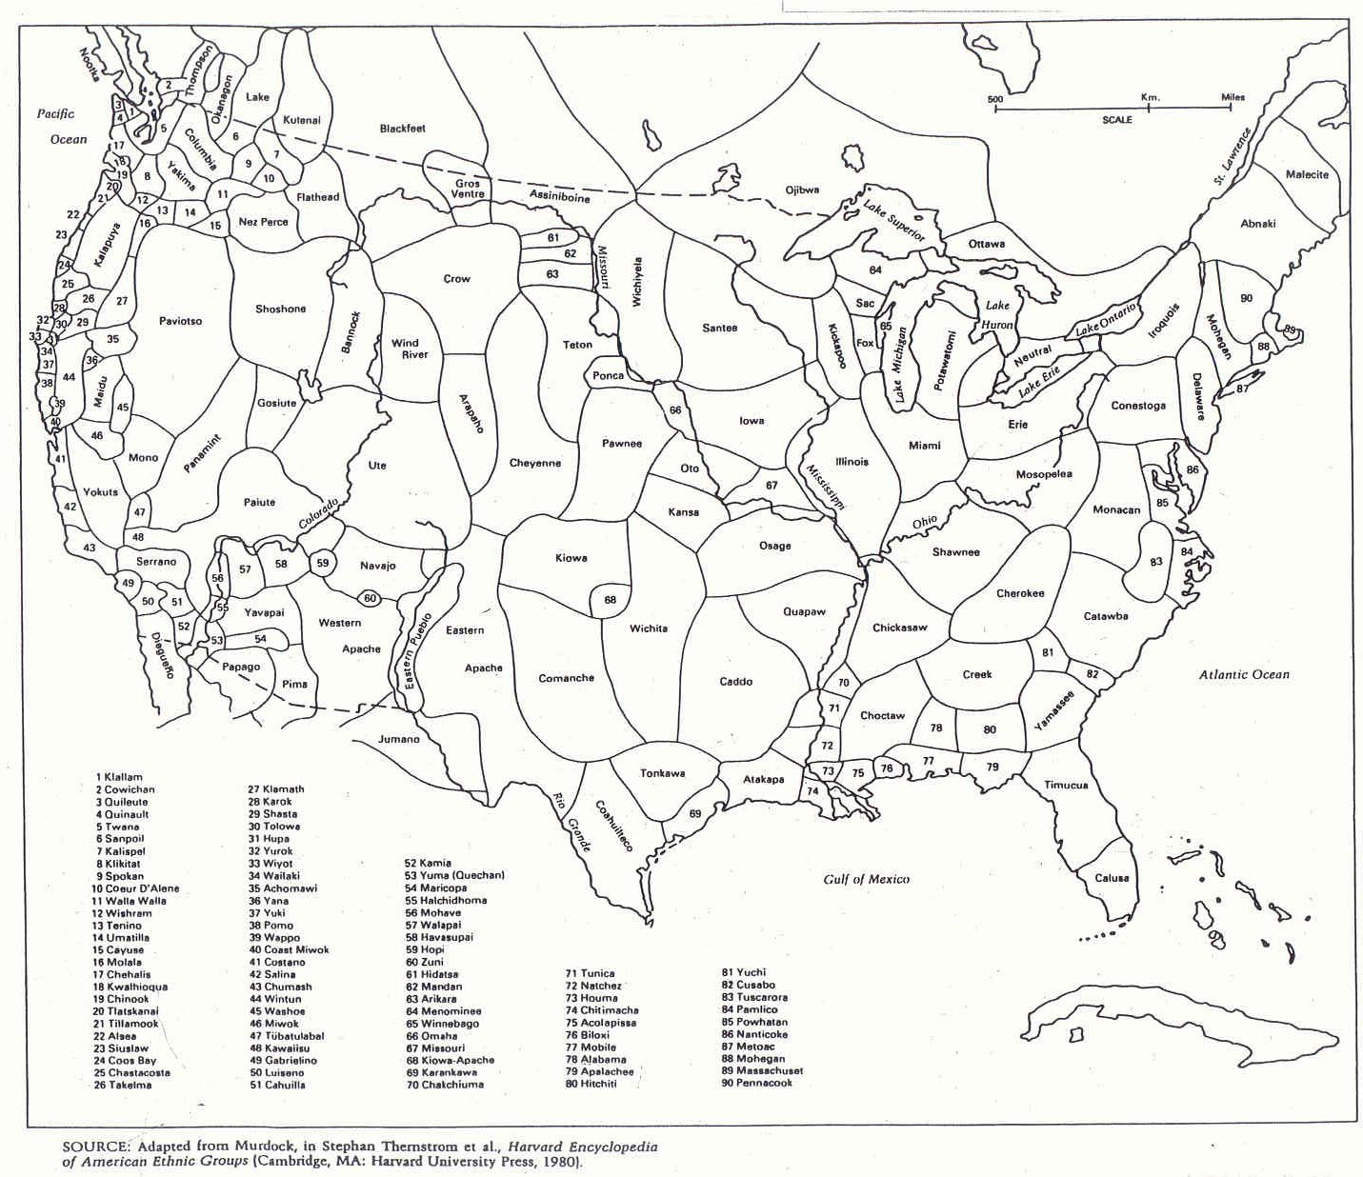
TERRITORIES OF FREE AND INDEPENDENT ORIGINAL NATIONS

Slide 31
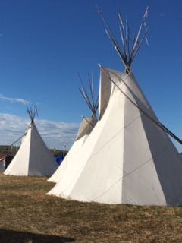
Our Original Nations - Living Sacred Life Ways,
Extending Back to the Beginning of Time

Slide 32
Wolakota Way of Life
Language, Culture, Spiritual Traditions
Woope
Seven Laws
Seven Sacred Sites
Seven Sacred Rites
The Black Hills
No corporeal punishment of children!
No religious wars!
No word in Lakota for Domination

Slide 33
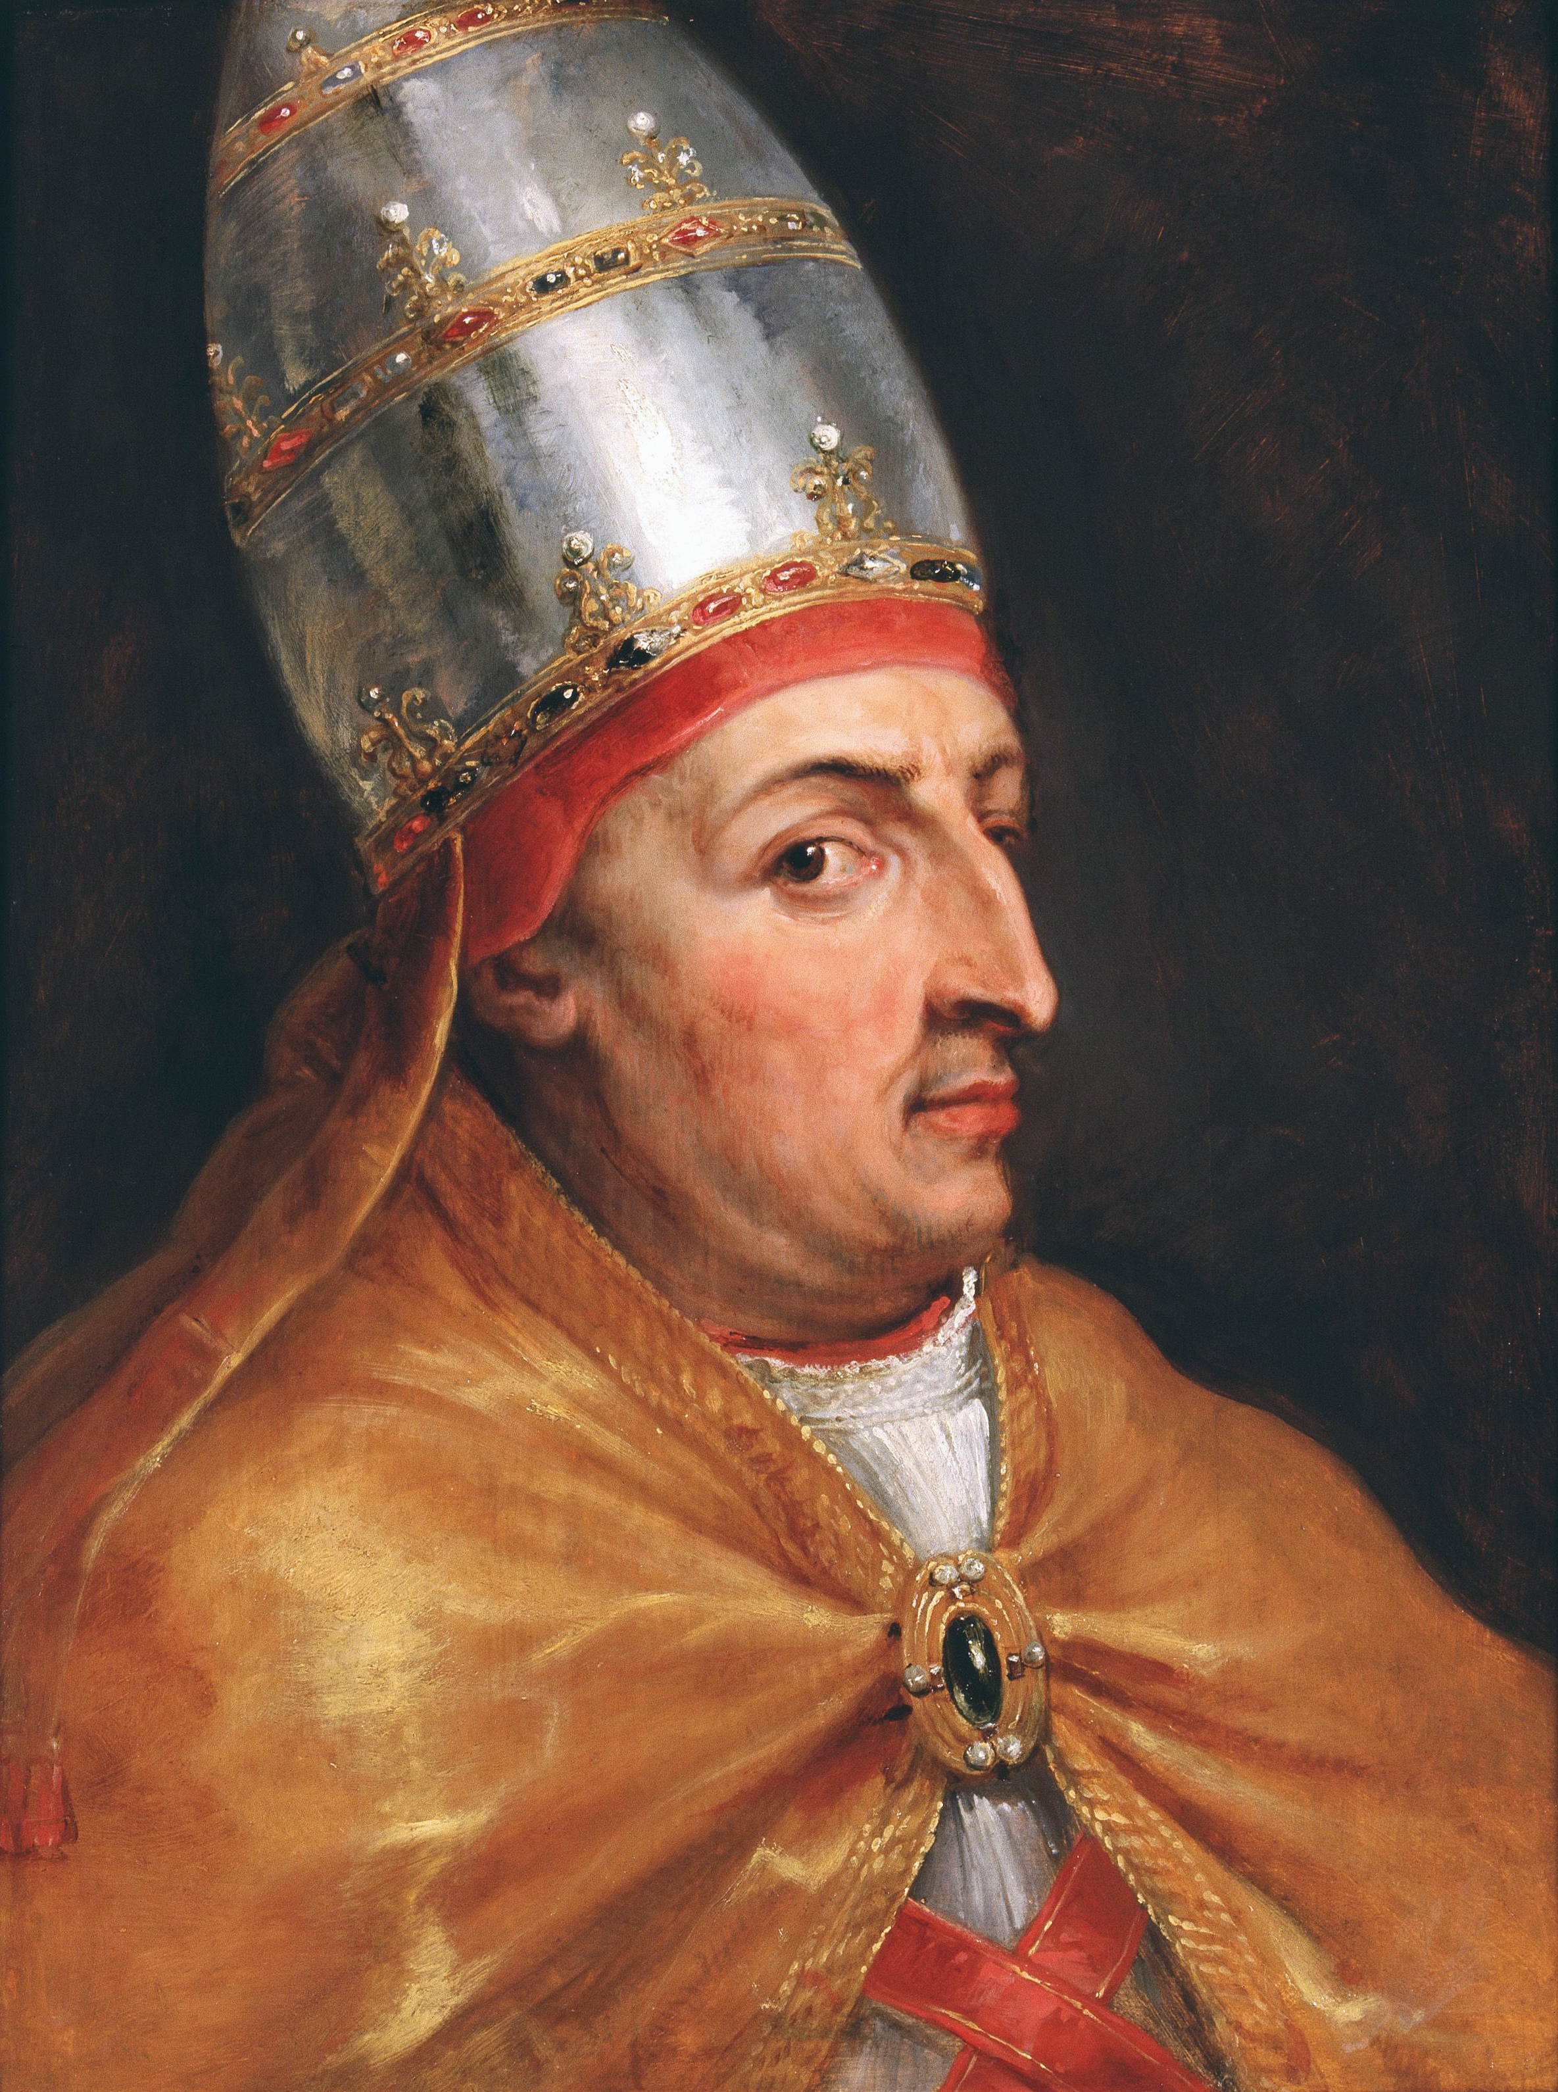
POPE NICHOLAS V – ORDERS THE ESTABLISHMENT OF DOMINATION (1452)
INVADE, CAPTURE, VANQUISH, SUBDUE, ALL NON-CHRISTIANS
REDUCE THEM TO SLAVERY, TAKE AWAY ALL THEIR POSSESSIONS AND PROPERTY

Slide 34
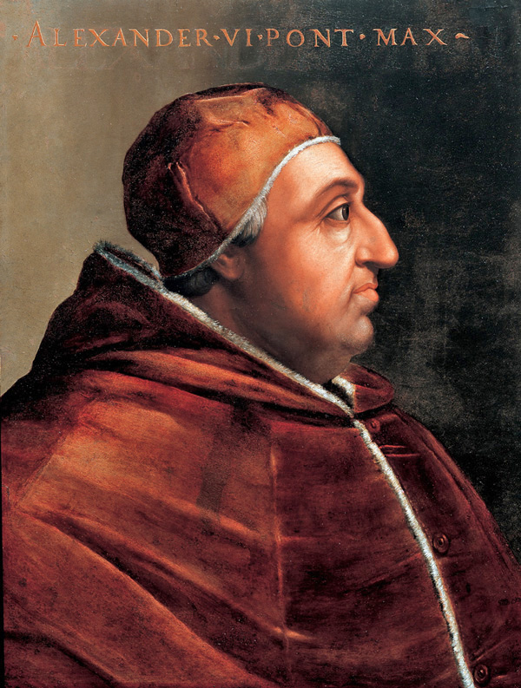
POPE ALEXANDER VI – 1493
THE DOMINATION CONCEPTS OF 1452 WERE INSERTED INTO THE PAPAL DOCUMENTS OF 1493
Lands discovered and to be discovered that are not yet under the domination (“dominio”) of any Christian dominators “dominorum Christianorum.”

Slide 35
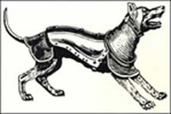
SPANISH DOGS OF WAR

Slide 36
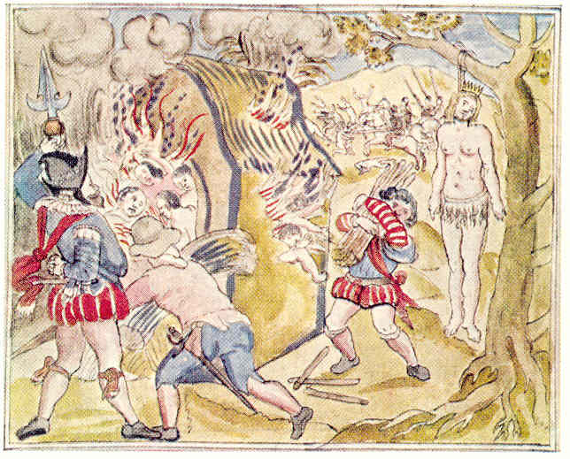
DOMINATION & DEHUMANIZATION

Slide 37
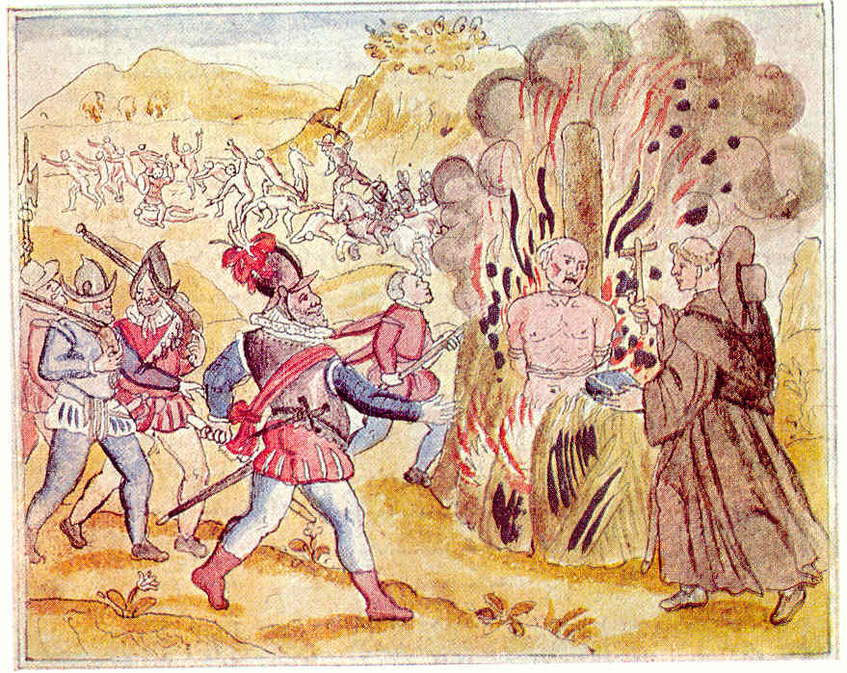
“Imperii Christiani Progationem Prosequi”
“Prosecute the Propagation of the Christian Empire”
Pope Alexander VI 1493

Slide 38
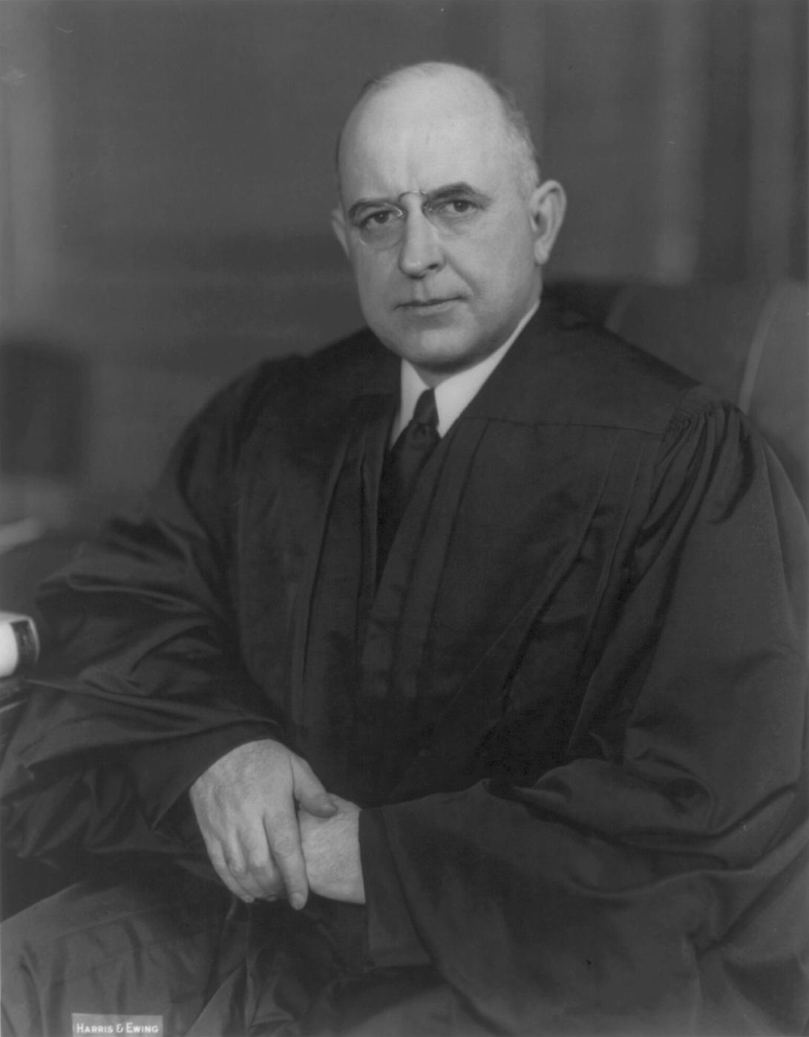
JUSTICE STANLEY REED 1946
REED SAID THAT DISCOVERY BY CHRISTIAN NATIONS GAVE THEM “SOVEREIGNTY” OVER AND THUS A RIGHT OF DOMINATION OVER ANY NON-CHRISTIAN LANDS IDENTIFIED BY THE CHRISTIAN WORLD

Slide 39
1954 U.S. Justice Department Legal Brief
Tee-Hit-Ton v. United States:
“Although the nations of Europe. . . ceased to recognize the Popes as the source of their titles to newly acquired land, the new concept of title by discovery was based upon the same idea. . .”
Lands where “heathens” and “infidels” were living were considered available for the establishment of a System of Domination by Christian nations.

Slide 40

In 1954 the U.S. Justice Department Admitted that the Claimed Right of Christian Domination is Woven into U.S. Indian Law & Policy
(Notice on the Seal “Domina Justicia” a Female Dominator
(Lady Justicia)

Slide 41

THE UNITED STATES USES SECTIONS OF THE BIBLE AS A BASIS FOR THE US DOMINATION OF THE OCETI SAKOWIN AND OTHER ORIGINAL NATIONS

Slide 42
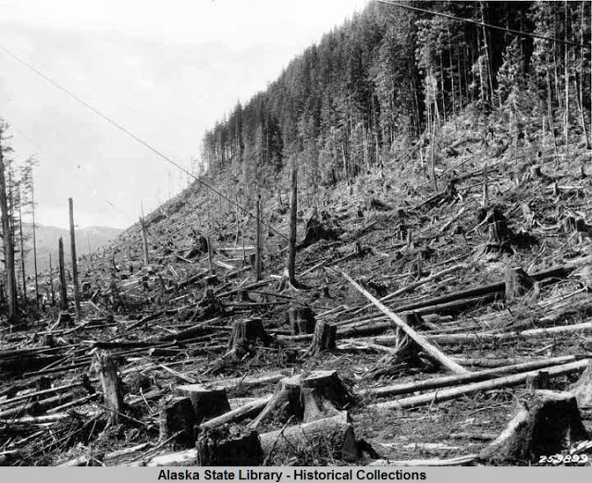
THE TEE-HIT-TON PEOPLE SHOULD NOT RECEIVE COMPENSATION FOR THEIR LANDS AND TIMBER BECAUSE HISTORICALLY THE CHRISTIAN NATIONS OF EUROPE MENTALLY IDENTIFIED THE LANDS OF “HEATHENS” AND “INFIDELS”

Slide 43
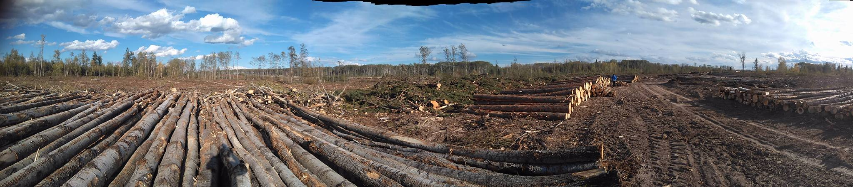
West central Saskatchewan
current day Mass clear cutting on “Treaty Protected” Indigenous Territory

Slide 44
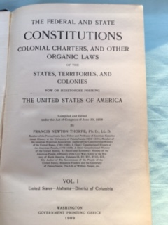

Slide 45
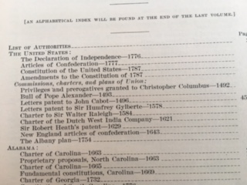

Slide 46
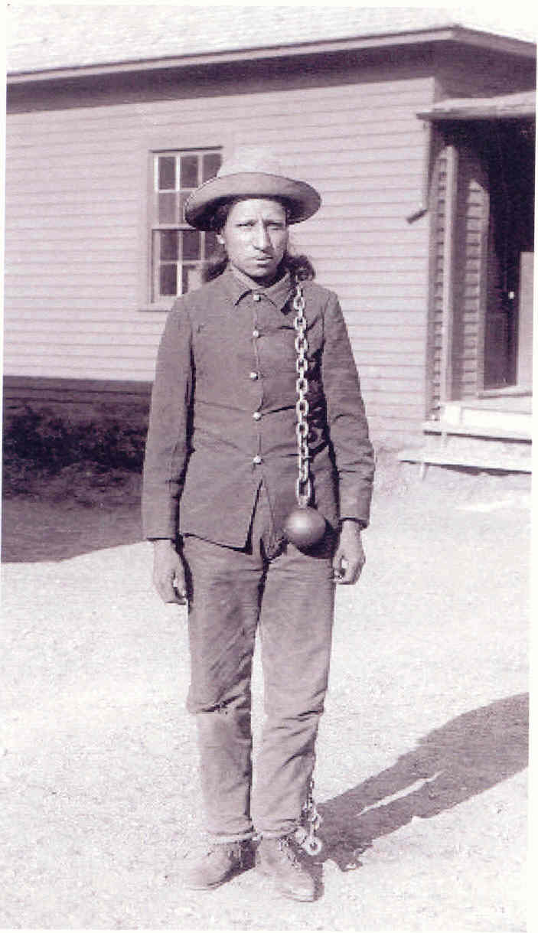
Ikce Wicasa Thomas Frosted
Forced Under Domination

Slide 47
Why “Reconciliation” (Acquiescence)
Makes No Sense:
There Can Be No Positive Relationship Between the System of Domination and Native Nations.
“Reconciliation” (Quiet Acceptance) Will Not End the Domination Systema
To quiet down, quell, or tap down rebelliousness

Slide 48
The Domination (state) of South Dakota
The Federal Domination (government)
Domination (state) Sales Tax
The Domination (property) Law System
The Federal Indian Domination (law) System

Slide 49
2023 will mark two hundred years since the US Supreme Court issued the Johnson v McIntosh ruling.
The next year will be an excellent time to build our momentum to publicize and challenge the domination system expressed in the Johnson v. McIntosh decision.

Slide 50
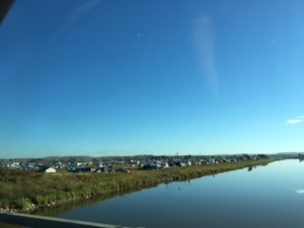
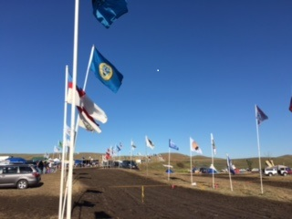
SEPTEMBER 2016 – STANDING ROCK

Slide 51
originalfreenations.com
Indigenous Law Institute
Redthought.org

